Slide 1
Tuition Class Tutes Registration System
Made By : Pavani Padyanjalee

Slide 2

Table of Contents
Introduction
Purpose
Functions
Interfaces

Slide 3
01) Introduction
In the class, when a new lesson begins or finishes, teacher has to keep in mind about the taught tutes.
Tutes are being stored in a physical file.
Storing, Updating, Inserting and removing the tutes are done manually.

Slide 4


This manual process is,
So Hard
Time Taking

Slide 5
02) Purpose
This new system will eliminate the disadvantages caused by the manual system by improving,
reliability
performance
efficiency

Slide 6
03) Functions
Entering details of a certain subject.
Retrieving the necessary details.
Deleting the relevant records.
Updating the records with relevant changes.
Providing a user friendly interface.

Slide 7
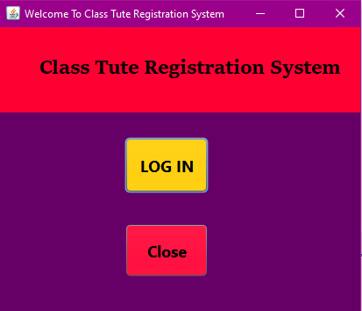
04) Interfaces

Slide 8
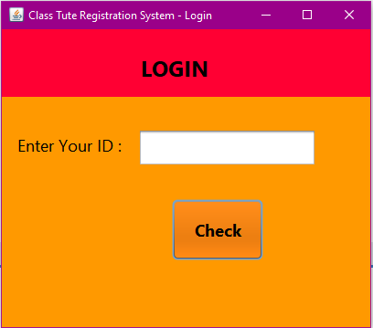

Slide 9
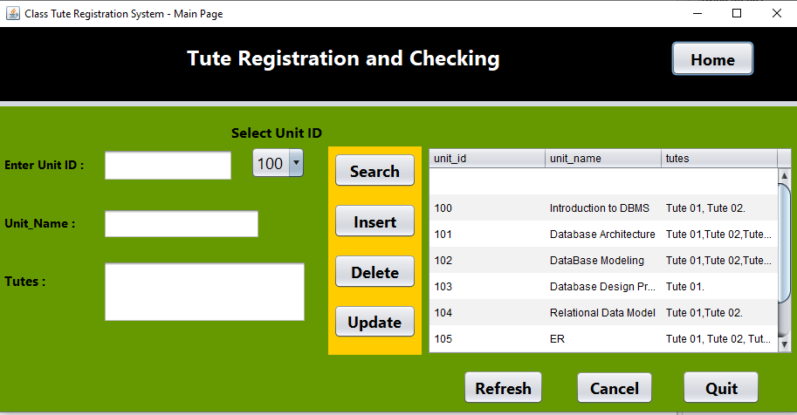

Slide 10

Thank You!

